Slide 1
Multi Core Processors and
Casino Programming
W. J. Paul
Vienna 2014
TexPoint fonts used in EMF.
Read the TexPoint manual before you delete this box.: AAAAAA

Slide 2
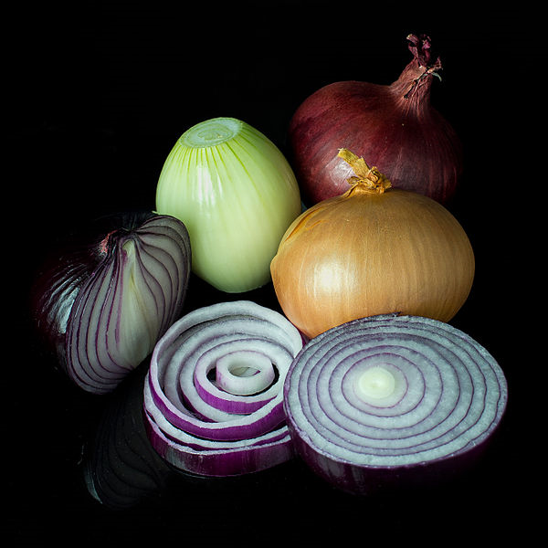
layers of system architecture
physical gates
different programming models on different layers
  instruction set architecture (ISA)…
  …
  parallel C + devices + macroassembly + assembly + interrupts
ISA
hypervisor

Slide 3
layer n of system architecture
user sees programming model (purple) provided by layer n
implementer implements it in programming model of layer n-1 (white)
implementations usually simple or wrong
  KISS
layer n-1
layer n

Slide 4
layer n of system architecture
user sees programming model (purple) provided by layer n
implementer implements it in programming model of layer n-1 (white)
implementations usually simple
easy IF we know programming model on layer n-1
layer n-1
layer n

Slide 5

if we only kind of know programming model of layer n-1…..
layer n-1, n…

Slide 6
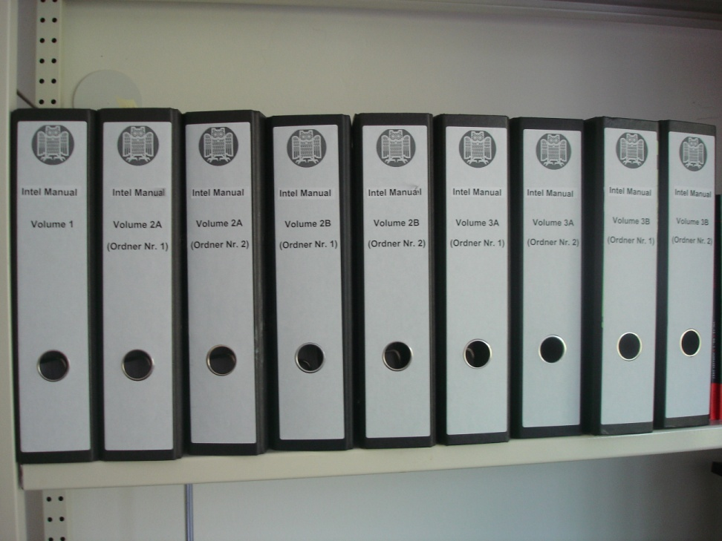
the casino is presently everywhere
ISA of multi core systems is only kind of known
  list of operating conditions in these 3000 pages might be incomplete
  complete list can be obtained by correctness proof of processor hardware
Semantics stack on top is
  not completely defined + justified

Slide 7

match

Slide 8

mismatch

Slide 9
mismatch
manufacturers of real time systems
  avoid multi core or
  turn presently off all parallel features they can
they know what they are doing

Slide 10
roadmap/plan of talk
ISA-sp for multi core processors
  MIPS 86 = MIPS + TSO
below:
  hardware correctness for multi core nondeterministic ISA
  collect operating conditions
  bottom of roadmap: digital gates
  bottom: physical gates
above:
  define semantics layers
  justify arguing about implementation in lower layers
  ownership and order reduction

Slide 11
ISA-sp:
disk
APIC
X64 ISA model
  E. Cohen: communicating sequential components; order of steps nondeterministic
  sb: store buffer
  mmu: memory management unit; walking of page tables nondeterministic (speculation)
  APIC: device, interrupts
  disk: for booting
mem + caches
sb
mmu
core

Slide 12
Nondeterministic ISA
hardware correctness
  induction on cycles t of deterministic hardware
  ne(t): number of nondeterministic ISA steps completed at cycle t
  oracle input o for these steps
    unit stepped
    initial walk guessed of MMU
    walk used by core

Slide 13
Implementation dependent operating conditions
pipeline stages
old: when is write to gpr visible ?
  forwarding and stalling
pc-translate
fetch
decode
execute
ea-translate
memory
gpr write back

Slide 14
Implementation dependent operating conditions
pipeline stages
when is write of an instruction visible
  speculation
  Kröning 1999
pc-translate
fetch
decode
execute
ea-translate
memory
gpr write back

Slide 15
Implementation dependent operating conditions
pipeline stages
when is write of an instruction or page table by other processor visible
  drain pipe + store buffer + sync
pc-translate
fetch
decode
execute
ea-translate
memory
gpr write back

Slide 16
invlpg
core:
  step at stage ‚memory‘
IMMU:
  step at stage ‚pc-translate‘; speculation in ISA.
  pipeline walk wo in ghost registers
  invariant: wo in virtual tlb
core step(wo)
  only allowed if invariant holds
invariant:
  inhibit use of translation in tlb invlpgd by instruction in stages decode…memory
  roll back pc-translate using translation invlpgd at stage fetch (speculative execution)
interrupt in stage decode
  changes to untranslated mode
  IMMU step in stage pc-translate would not occur in deterministic ISA
  was speculated in nondeterministic ISA (even with deterministic MMU)
pipeline stages
pc-translate
wo
fetch
decode
execute
ea-translate
memory
gpr write back

Slide 17
Invlpg: can be implemented without software condition in nodeterministic ISA
core:
  step at stage ‚memory‘
IMMU:
  step at stage ‚pc-translate‘; speculation in ISA.
  pipeline walk wo in ghost registers
  invariant: wo in virtual tlb
core step(wo)
  only allowed if invariant holds
invariant:
  inhibit use of translation in tlb invlpgd by instruction in stages decode…memory
  roll back pc-translate using translation invlpgd at stage fetch (speculative execution)
interrupt in stage decode
  changes to untranslated mode
  IMMU step in stage pc-translate would not occur in deterministic ISA
  was speculated in nondeterministic ISA (even with deterministic MMU)
pipeline stages
pc-translate
wo
fetch
decode
execute
ea-translate
memory
gpr write back

Slide 18
current research/last for hardware
pipeline stages
When are device steps visible in multicore machines?
pc-translate
fetch
decode
execute
ea-translate
memory
gpr write back

Slide 19
ISA +devices and driver correctness (Dublin 2009)
  hardware parallel even with sequential processor
  ISA nondeterministic concurrent, 1 step at a time
  disable interrupts of devices >1 and don‘t poll them
  reorder their device steps out of driver run of dev 1
  pre and post conditions for drivers…
dev 1
proc
dev k

Slide 20

ISA +devices and driver correctness
  disable interrupts of devices >1 and don‘t poll them
  reorder their device steps out of driver run of dev 1
  pre and post conditions for drivers…
  assumes absence of side channels
dev 1
proc
dev k

Slide 21
ISA +devices and driver correctness
  disable interrupts of devices >1 and don‘t poll them
  reorder their device steps out of driver run of dev 1
  pre and post conditions for drivers…
  Device 1: motor
  Device 2: clima
  Side channel: power consumption
dev 1
proc
dev k

Slide 22
C + assembly (Kirkland 2013 extended)

Slide 23
C + devices
Implementation
  access device ports by assembly code
  do not allocate C variables to ports
  disable interrupts during run of translated C code
Order reduction: devices steps can be reordered to assembly portion
Semantics
  Configurations (a,c,d) or (a,d)
  d for device
  device steps only for (a,d)

Slide 24
Ownership (1) concept
Classify addresses
  local (e.g. C stack)
  shared and read only (e.g. program)
  shared owned (temporarily local/locked)
  shared writeable not owned (locks)
invariants:
  at most 1 owner ….
  disjointness…
safe programs: act like names of address classes suggest
accesses to class 4 atomic at the language level

Slide 25
Ownership (2)
Def: structured parallel C (almost folklore)
Classify addresses
  local (e.g. C stack)
  shared and read only (e.g. program)
  shared owned (temporarily local/locked)
  shared writeable not owned (locks)
multiple C threads
sequentially consistent memory !
shared: heap + global variables
local: stacks
safe w.r.t. ownership
  class 4 access: volatile
Interleave at (compiler consistency points before) class 4 accesses

Slide 26
Ownership (3) structured parallel C to parallel assembly
IF
  translate threads with sequential compiler
  translate volatile C access to interlocked ISA access
  at most 1 class 4 access between two interleaving points (e.g. no global pointer chasing to global variable)
THEN
  ISA program safe
  multicore ISA simulates parallel C
Baumann 2014

Slide 27
Ownership (4) parallel store buffer reduction in ISA-sp
dirty
maintain local dirty bits
  class 4 write since last local sb- flush
class 4 read only if dirty =0
Cohen Schirmer ITP 2010: store buffers invisible
  formal, 70 pages proof
  no mmu
push through hierarchy
  implement sb-flush as compiler intrinsic in C
C
compiler
m-asm
m-assembler
ISA-u=asm
before
ISA-sp

Slide 28
Ownership (5) parallel store buffer reduction in ISA-sp
dirty
maintain local dirty bits
  class 4 write since last local sb- flush
class 4 read only if dirty =0
Chen Cohen Kovalev (VSTTE 2014: store buffers invisible
  94 pages proof
  with mmu
  page tables local to processor + mmu or shared
  new ownership class: locally shared. Processor access while local mmu walks: class 4
C
compiler
m-asm
m-assembler
ISA-u=asm
before
ISA-sp

Slide 29
Ownership (6): Semantics of C + interrupts
Pentchev 2014
C program thread + handler threads
  ownership discipline between program and handler thread
  interleave at consistency points around class 4 accesses
Parallel C program threads + handler threads
  ownership as for structured parallel C for local threads + handlers
  new ownership class: locally shared between program thread and handler

Slide 30
Summary
Hardware
  search of software conditions almost completed (except multicore + devices)
  so far only known type of software conditions found
  with nondeterministic ISA no software conditions for use of invlpg
Sofware stack
  C + assembly
  C + devices
  structured Parallel C
  store buffer reduction with MMUs
  C + interrupts

Slide 31
Once this research is done
we could quit
if we wanted to

