Slide 1

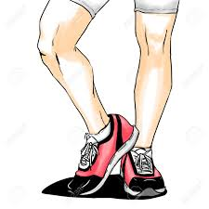
BDDs on the Run
event C
event B
event A
Klaus Havelund (NASA JPL, USA)
Doron Peled (Bar Ilan University, Israel)
(Dogan Ulus (Boston University))
IFIP WG Meeting 1.9/2.15
Oxford July 2018

Slide 2
Runtime verification (RV)
Verification of executions of complex systems
where full formal verification is not an option.
Follows an execution and check it against a temporal property.
Can issue warning if property is violated (satisfied).
While model checking can check unbounded executions in a model, RV checks the prefixes of actual executions.

Slide 3
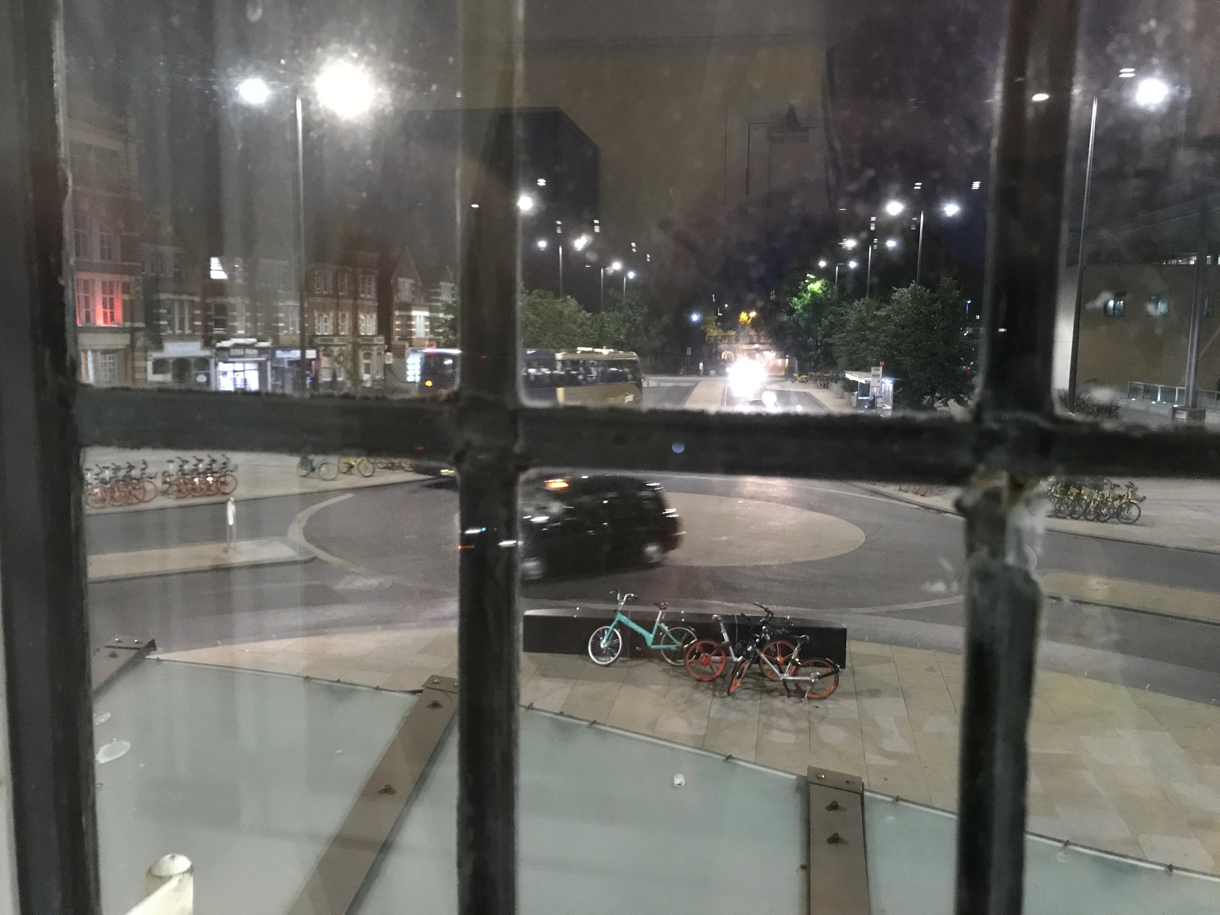
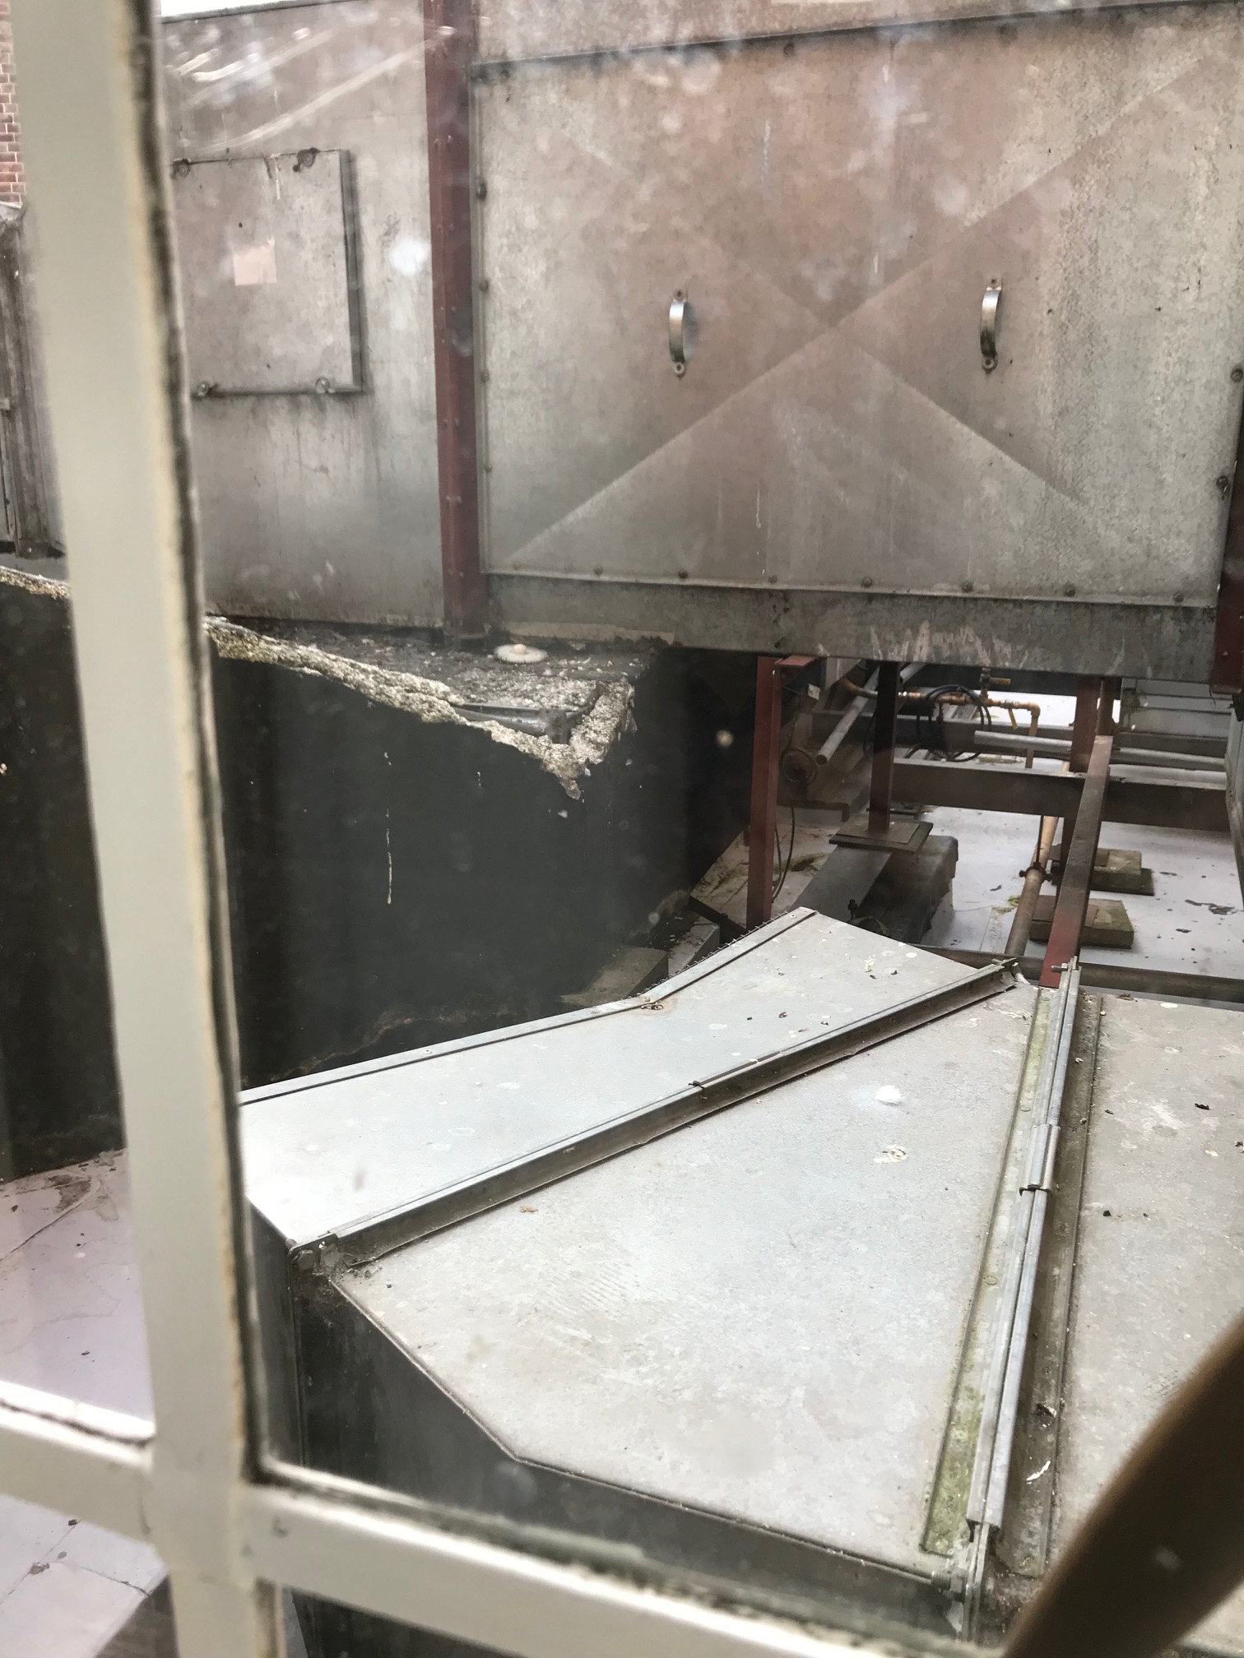
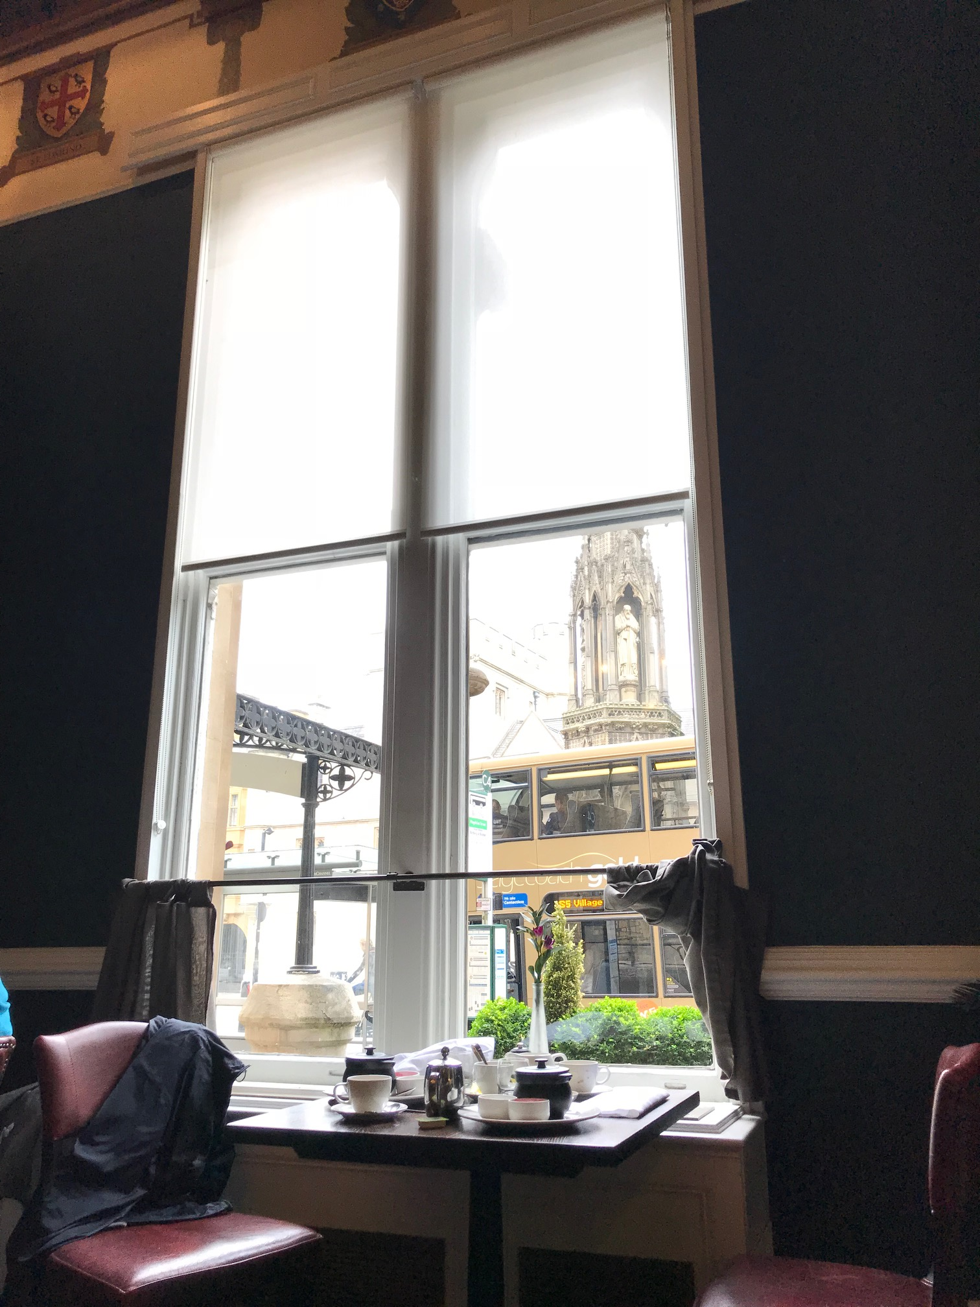
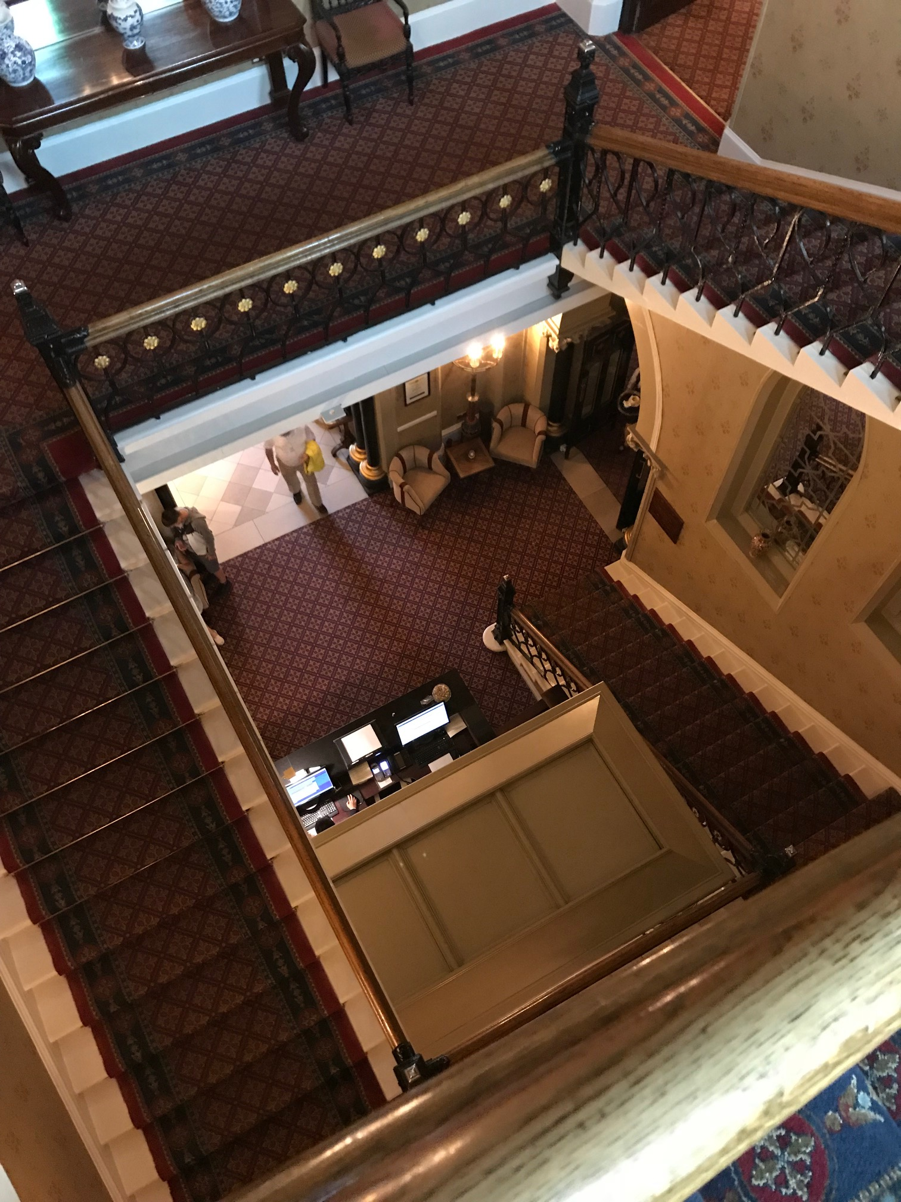
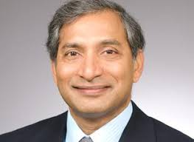
SYSTEM
MONITOR
≤ 250$/night

Slide 4


Past time temporal formulas

Slide 5
Past time temporal formulas
open(“tel”)
open(“dict”)
open(“out”)
close(“tel2”)
We need to save all past values of file names that were opened, and compare them with the current one that is closed.

Slide 6
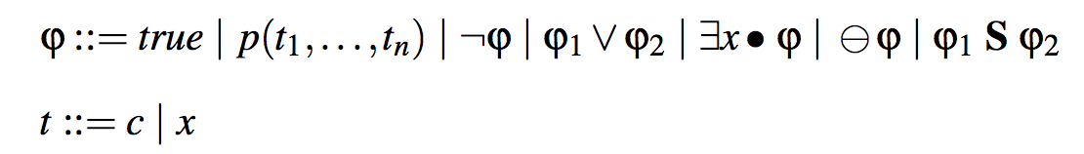
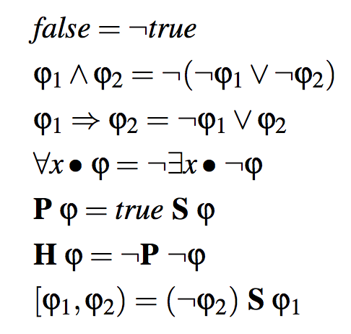
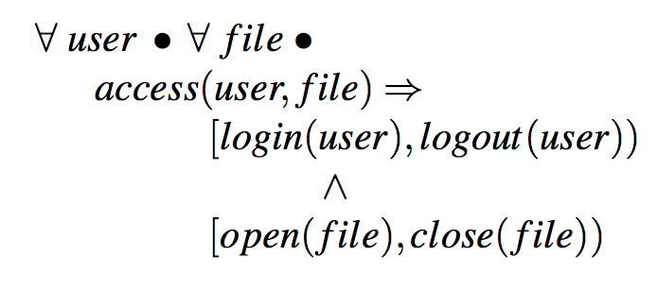
The Logic QTL (quantified past temporal logic)
Derived Constructs
Example

Slide 7
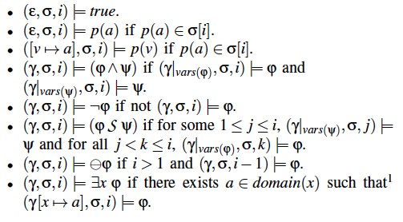
First Semantics: the “standard” definition

Slide 8
Lets look at a particular formula:
∃y ∃x (p(x) S q(y))
p(7),P(8),p(9)
P(9),p(10),p(11)
q(5)
p(6),p(7),p(8)
p(8),p(9),p(10)
The answer is F: there is no common value of p(x) since q(5).
Standard semantics does not give a good intuition how to perform this bookkeeping!

Slide 9
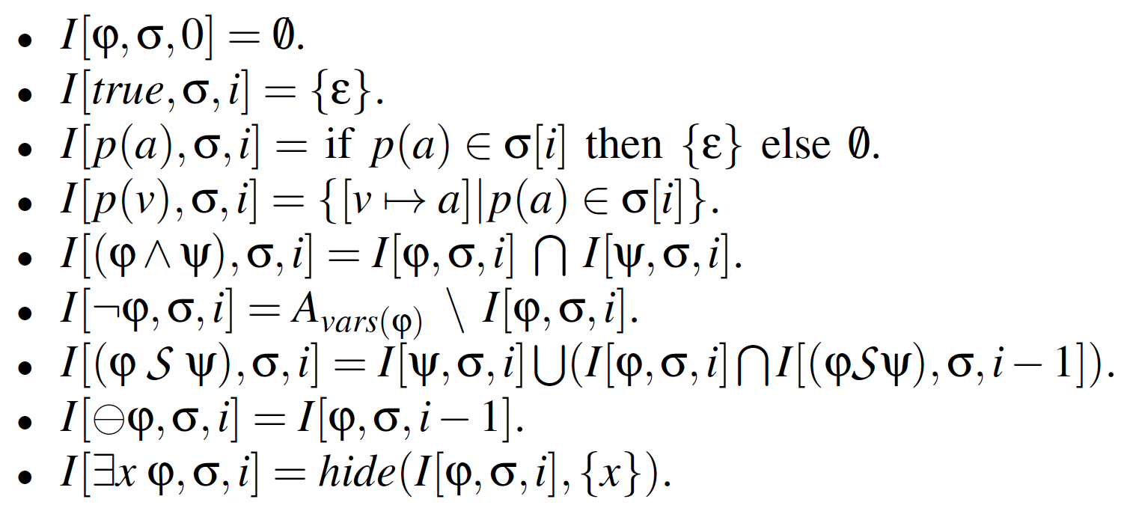
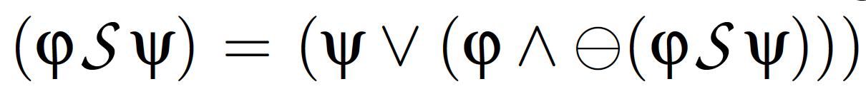

Second Semantics: formula + trace + position denotes a set of assignments
complement
set
=
infinite set
Theorem:

Slide 10
Representing sets of assignments as BDDs
not(p) ∧ q ∧ not(r)
We can replace the set operations with BDD operations:
- Set union ∪ by BDD disjunction ∨
- Set intersection ∩ by BDD conjunction ∧,
- Set complementation \ by BDD negation ¬ (simply swap F and T at leaf level)
Notes:
order(r, q, p) ;
or(and(p,q,r), and(p,q,not(r))) ;
print($1) ;

Slide 11
We enumerate values in binary.
We store mapping between values and enums.
open(“tel”)
open(“dict”)
open(“out”)
close(“tel2”)
opened = {“tel”, “dict”,”out”}
b₂b₁b₀
“tel”
000
{000, 001, 010}
Value to
bit string
table
“dict”
001
“out”
010
(!b₂ ∧ !b₁ ∧ !b₀) ∨
(!b₂ ∧ !b₁ ∧ b₀) ∨
(!b₂ ∧ b₁ ∧ !b₀)
“tel2”
011

Slide 12
000
b₂b₁b₀
“tel”
000
Value to
bit string
table
“dict”
001
“out”
010
“tel2”
011
Notes:
http://eecs.ceas.uc.edu/~weaversa/BDD_Visualizer.html
---
order(b2, b1, b0) ;
and(not(b0), not(b1), not(b2)) ;
print($1) ;
---
order(b2, b1, b0) ;
and(not(b0), not(b1), b2) ;
print($1) ;
---
order(b2, b1, b0) ;
and(not(b0), b1, not(b2)) ;
print($1) ;
---
order(b2, b1, b0) ;
and(not(b0), b1, b2) ;
print($1) ;

Slide 13
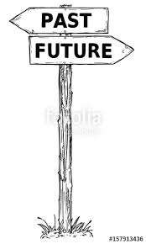
Accounting for values not seen yet
000
001
010
111
unused enumerations represent values not seen so far.
In particular, the value
11…111
represents all values not yet seen
Notes:
order(b2, b1, b0) ;
or(
and(not(b0), not(b1), not(b2)),
and(not(b0), not(b1), b2),
and(not(b0), b1, not(b2))
) ;
print($1) ;

Slide 14
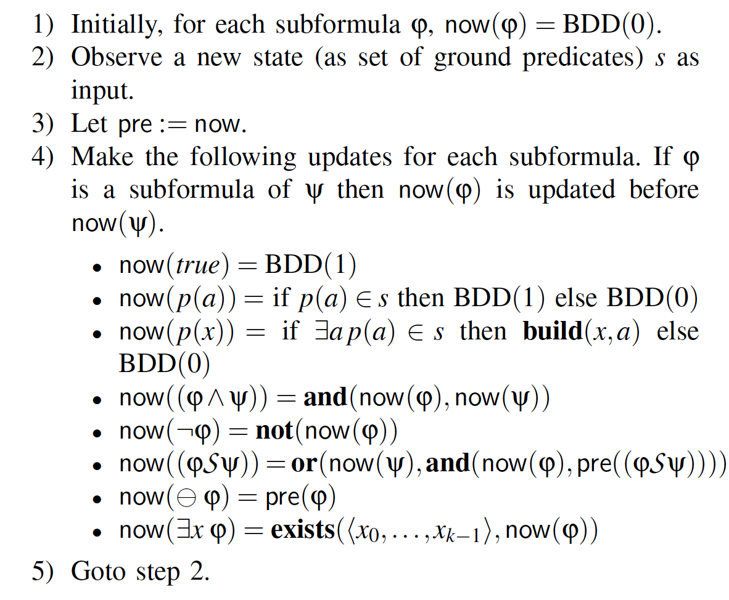

Algorithm
Using BDD operations!
var pre : BDD
var now : BDD

Slide 15
Lets return to the following formulas:
They are quite different, not only because the 2nd one seems more accurate, not allowing to close an open file twice.
With the 1st formula, if we forget a name of a file that was opened, then we cannot anymore compare against it the closed files.
With the 2nd formula, once an open file gets closed, we can forget that it was opened [but if it is later opened again, we need to remember that again.]

Slide 16
Lets return to the following formulas:
But how to identify when this is possible?

Slide 17
Garbage collection in BDDs:
We identify enumerations (of values) that are not using the following idea:
Not useful enumerations are related to other enumerations in the same way as the value 111…111 (which stands for values not seen so far).
Suppose we have variables x, y, z and want to free enumerations for x.
This can be checked using the above type of BDD formula for each variable, then intersection over all subformula.

Slide 18
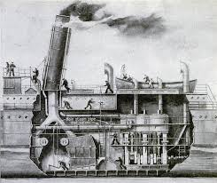
Implementation

Slide 19

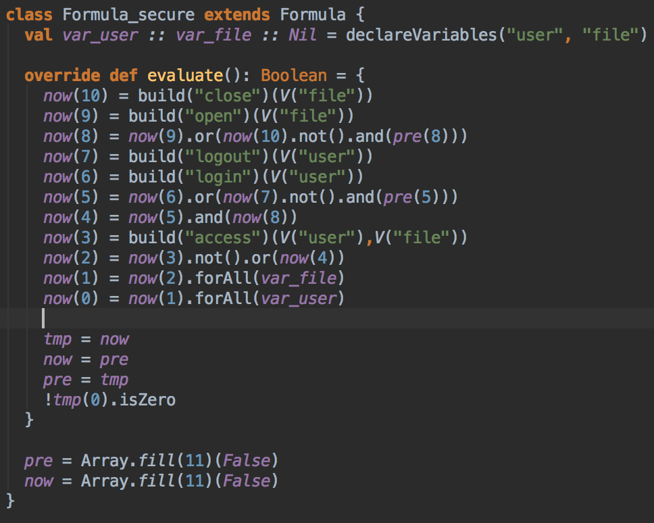

Architecture
prop secure :
forall (user) forall (file)
access(user,file) ->
[login(user),logout(user))
&
[open(file),close(file))
JavaBDD
Scala parser
combinators
login,John
open,tel
access,John,tel
close,tel
access,John,tel
logout,John
Apache commons CSV
(Comma Separated Value format)
parser
*** Property secure violated on event number 5:
access(John,tel)

Slide 20
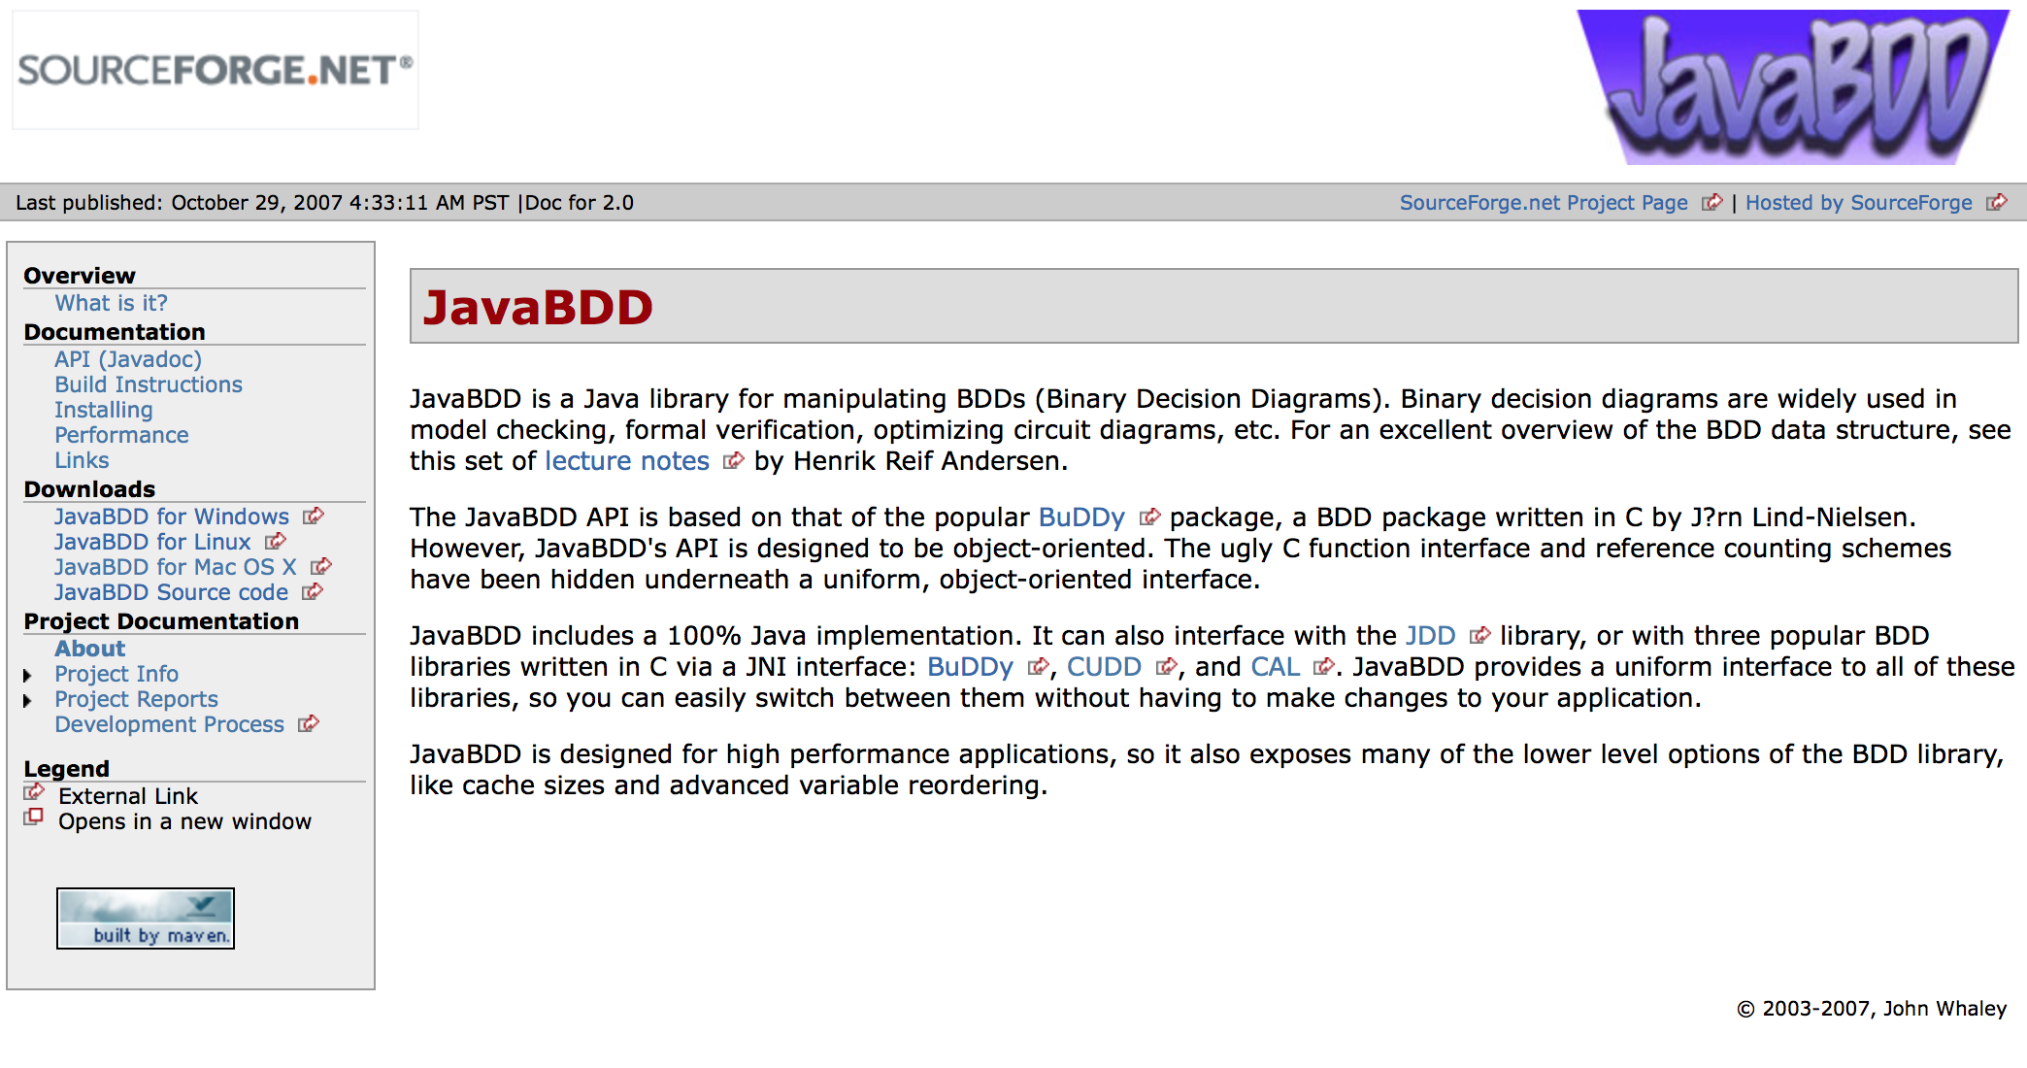
http://javabdd.sourceforge.net

Slide 21
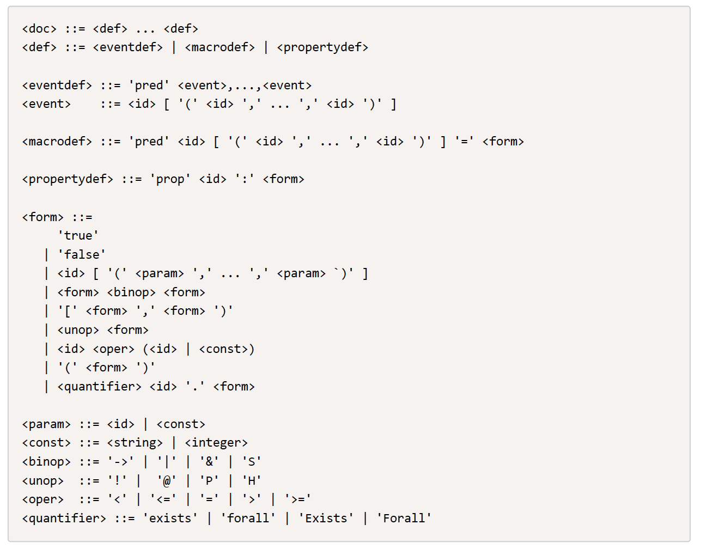

Slide 22
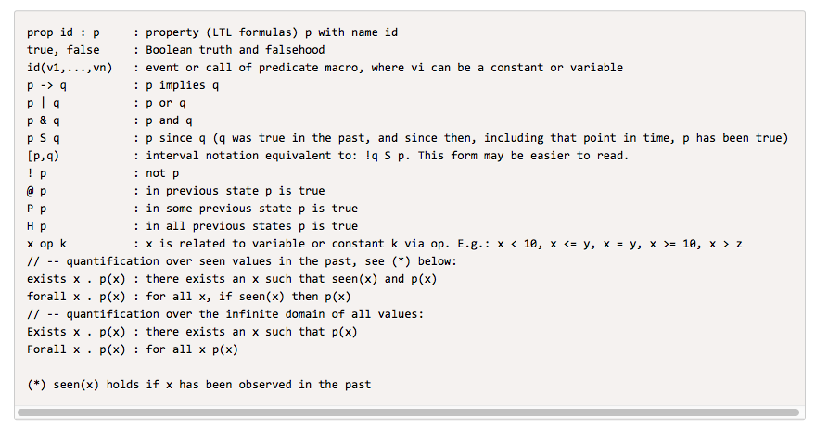

Slide 23

Example property and trace
prop p : Forall f. (Exists d. write(f,d)) -> !close(f) S open(f)
2 bits: 00, 01, 10 (11 is reserved)
open(f1)
open(f2)
open(f3)
close(f1)
close(f2)
close(f3)
open(f1)
open(f4)
write(f4,2)

Slide 24
dejavu spec.qtl log.csv 2

Slide 25
prop p : Forall f. (Exists d. write(f,d)) -> !close(f) S open(f)
def evaluate(): Boolean = {
now(7) = build("open")(V("f"))
now(6) = build("close")(V("f"))
now(5) = now(6).not()
now(4) = now(7).or(now(5).and(pre(4)))
now(3) = build("write")(V("f"),V("d"))
now(2) = now(3).exist(var_d.quantvar)
now(1) = now(2).not().or(now(4))
now(0) = now(1).forAll(var_f.quantvar)
val error = now(0).isZero
tmp = now; now = pre; pre = tmp
!error
}

Slide 26
open(f1)
open(f2)
open(f3)
close(f1)
close(f2)
close(f3)
open(f1)
open(f4)
write(f4,2)
|=
prop p : Forall f. (Exists d. write(f,d)) -> !close(f) S open(f)

Slide 27
CSV FORMAT:
open,f1
open,f2
open,f3
close,f1
close,f2
close,f3
open,f1
open,f4
write,f4,2
|=
prop p : Forall f. (Exists d. write(f,d)) -> !close(f) S open(f)
Formula contains two variables: f, m
Two bits per variable, giving combinations
00, 01, 10, and 11
11 is devoted to represent values not yet seen.
Therefore two bits can represent three values
per variable: 00, 01, 10.

Slide 28
open,f1
open,f2
open,f3
close,f1
close,f2
close,f3
open,f1
open,f4
write,f4,2
|=
prop p : Forall f. (Exists d. write(f,d)) -> !close(f) S open(f)
Bit patterns b₁b₀ available for f:
00, 01, 10
Namely all that
differ from: 11,
which is only pattern leading to 0.
avail(f) initially

Slide 29
open,f1
open,f2
open,f3
close,f1
close,f2
close,f3
open,f1
open,f4
write,f4,2
|=
prop p : Forall f. (Exists d. write(f,d)) -> !close(f) S open(f)
BDD for f1: 10.
Picked from avail(f) with SAT solver.

Slide 30
open,f1
open,f2
open,f3
close,f1
close,f2
close,f3
open,f1
open,f4
write,f4,2
|=
prop p : Forall f. (Exists d. write(f,d)) -> !close(f) S open(f)
BDD for all files opened and not closed since.
This is file f1 just opened, represented by 01.
Same as for node 7.

Slide 31

open,f1
open,f2
open,f3
close,f1
close,f2
close,f3
open,f1
open,f4
write,f4,2
|=
prop p : Forall f. (Exists d. write(f,d)) -> !close(f) S open(f)

Slide 32
open,f1
open,f2
open,f3
close,f1
close,f2
close,f3
open,f1
open,f4
write,f4,2
|=
prop p : Forall f. (Exists d. write(f,d)) -> !close(f) S open(f)

Slide 33

open,f1
open,f2
open,f3
close,f1
close,f2
close,f3
open,f1
open,f4
write,f4,2
|=
prop p : Forall f. (Exists d. write(f,d)) -> !close(f) S open(f)

Slide 34
open,f1
open,f2
open,f3
close,f1
close,f2
close,f3
open,f1
open,f4
write,f4,2
|=
prop p : Forall f. (Exists d. write(f,d)) -> !close(f) S open(f)

Slide 35
open,f1
open,f2
open,f3
close,f1
close,f2
close,f3
open,f1
open,f4
write,f4,2
|=
prop p : Forall f. (Exists d. write(f,d)) -> !close(f) S open(f)
Available bit patterns b₁b₀ for f after allocating 10 are 00, 01.
That is: leftmost bit (b1) is 0.
Note: BDD does not refer to b0.
avail(f)

Slide 36
open,f1
open,f2
open,f3
close,f1
close,f2
close,f3
open,f1
open,f4
write,f4,2
|=
prop p : Forall f. (Exists d. write(f,d)) -> !close(f) S open(f)
Pattern 01 is allocated to f2.

Slide 37
open,f1
open,f2
open,f3
close,f1
close,f2
close,f3
open,f1
open,f4
write,f4,2
|=
prop p : Forall f. (Exists d. write(f,d)) -> !close(f) S open(f)
represents the patterns:
10 for file f1
01 for file f2
Those opened and not closed since.
OR(BDD(10),BDD(01))

Slide 38
open,f1
open,f2
open,f3
close,f1
close,f2
close,f3
open,f1
open,f4
write,f4,2
|=
prop p : Forall f. (Exists d. write(f,d)) -> !close(f) S open(f)

Slide 39
open,f1
open,f2
open,f3
close,f1
close,f2
close,f3
open,f1
open,f4
write,f4,2
|=
prop p : Forall f. (Exists d. write(f,d)) -> !close(f) S open(f)

Slide 40
open,f1
open,f2
open,f3
close,f1
close,f2
close,f3
open,f1
open,f4
write,f4,2
|=
prop p : Forall f. (Exists d. write(f,d)) -> !close(f) S open(f)
Last available pattern 00 assigned to f3.
avail(f) becomes FALSE.

Slide 41
open,f1
open,f2
open,f3
close,f1
close,f2
close,f3
open,f1
open,f4
write,f4,2
|=
prop p : Forall f. (Exists d. write(f,d)) -> !close(f) S open(f)
Represents all patterns for files f1, f2, f3:
10, 01, 00
These are the patterns different from 11.

Slide 42
open,f1
open,f2
open,f3
close,f1
close,f2
close,f3
open,f1
open,f4
write,f4,2
|=
prop p : Forall f. (Exists d. write(f,d)) -> !close(f) S open(f)
After removal of pattern 10 for file f1.
Resulting patterns: 01, 00
for files f2, f3.
That is: leftmost bit (b1) is 0.

Slide 43
open,f1
open,f2
open,f3
close,f1
close,f2
close,f3
open,f1
open,f4
write,f4,2
|=
prop p : Forall f. (Exists d. write(f,d)) -> !close(f) S open(f)
After closing all files …
and
avail(f) = FALSE
as well.

Slide 44
open,f1
open,f2
open,f3
close,f1
close,f2
close,f3
open,f1
open,f4
write,f4,2
|=
prop p : Forall f. (Exists d. write(f,d)) -> !close(f) S open(f)
Reuse pattern 10 for file f1.
No need for GC.

Slide 45
open,f1
open,f2
open,f3
close,f1
close,f2
close,f3
open,f1
open,f4
write,f4,2
|=
prop p : Forall f. (Exists d. write(f,d)) -> !close(f) S open(f)
f1 (10) is now the only opened file.

Slide 46
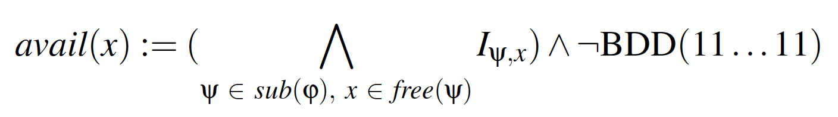
open,f1
open,f2
open,f3
close,f1
close,f2
close,f3
open,f1
open,f4
write,f4,2
|=
prop p : Forall f. (Exists d. write(f,d)) -> !close(f) S open(f)
Opening of file f4 causes GC since f4 has not been previously seen, and avail(f) = FALSE.
We must re-compute new avail(f), and from this select f4’s pattern.
Re-Compute avail(f):
Compute for each subformula patterns for ‘f’ that behave like 11. These are not needed and can be collected.
Take their intersection (AND) and remove 11.

Slide 47
open,f1
open,f2
open,f3
close,f1
close,f2
close,f3
open,f1
open,f4
write,f4,2
|=
prop p : Forall f. (Exists d. write(f,d)) -> !close(f) S open(f)
Since f1 (10) was re-opened, the patterns not used are those different from 10:
01, 00, 11
Which is:
NOT(10)
Iψ₄,f

Slide 48
open,f1
open,f2
open,f3
close,f1
close,f2
close,f3
open,f1
open,f4
write,f4,2
|=
prop p : Forall f. (Exists d. write(f,d)) -> !close(f) S open(f)
Now subtract 11 from that and we get avail(f):
01, 00
which are all patterns where most significant bit b1 is 0.
avail(f) = {01,00}

Slide 49
open,f1
open,f2
open,f3
close,f1
close,f2
close,f3
open,f1
open,f4
write,f4,2
|=
prop p : Forall f. (Exists d. write(f,d)) -> !close(f) S open(f)
Since
avail(f) = {01,00}
SAT(avail(f)) = 01
as pattern for f4.

Slide 50
open,f1
open,f2
open,f3
close,f1
close,f2
close,f3
open,f1
open,f4
write,f4,2
|=
prop p : Forall f. (Exists d. write(f,d)) -> !close(f) S open(f)
f
Illustrates multiple variables: f, d.
f := 01 (for f4)
the just allocated.
d := 10 (for 2)
first allocation for d.
d
[f -> 01, d -> 10] represents [f -> f4, d -> 2]

Slide 51
open,f1
open,f2
open,f3
close,f1
close,f2
close,f3
open,f1
open,f4
write,f4,2
|=
prop p : Forall f. (Exists d. write(f,d)) -> !close(f) S open(f)
Existential quantification over d:
remove d’s BDD variables b2 and b3 and repoint b2’s incoming arrow to leaf node 1.

Slide 52
Recall the formula for collecting garbage

Slide 53
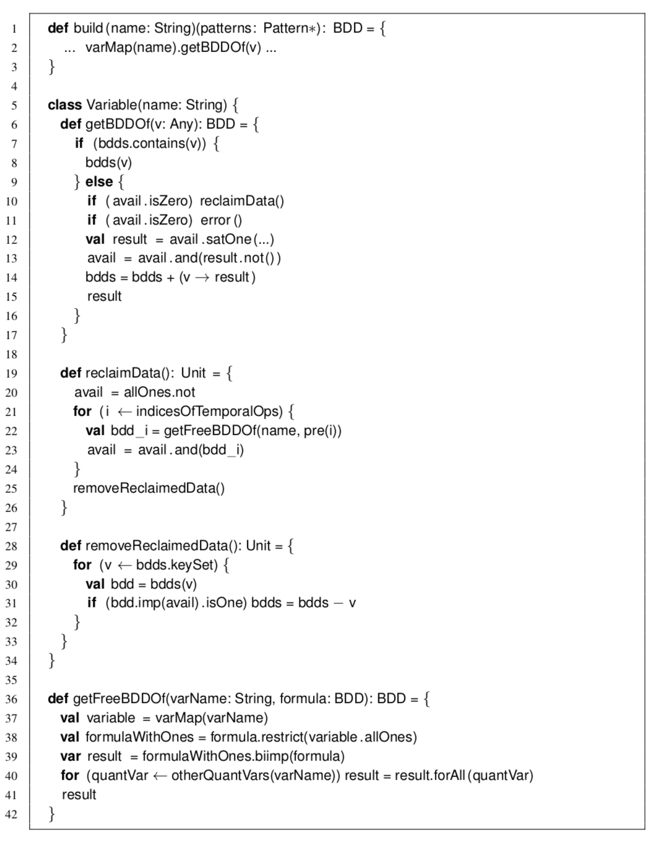
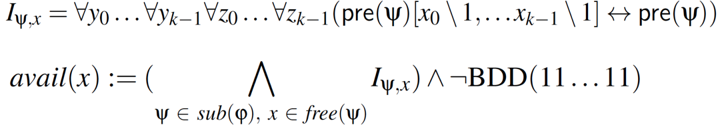
Implementation:
def evaluate(): Boolean = {
now(7) = build("open")(V("f"))
now(6) = build("close")(V("f"))
now(5) = now(6).not()
now(4) = now(7).or(now(5).and(pre(4)))
now(3) = build("write")(V("f"),V("d"))
now(2) = now(3).exist(var_d.quantvar)
now(1) = now(2).not().or(now(4))
now(0) = now(1).forAll(var_f.quantvar)
val error = now(0).isZero
tmp = now; now = pre; pre = tmp
!error
}
$$bdd ∈avail$$

Slide 54
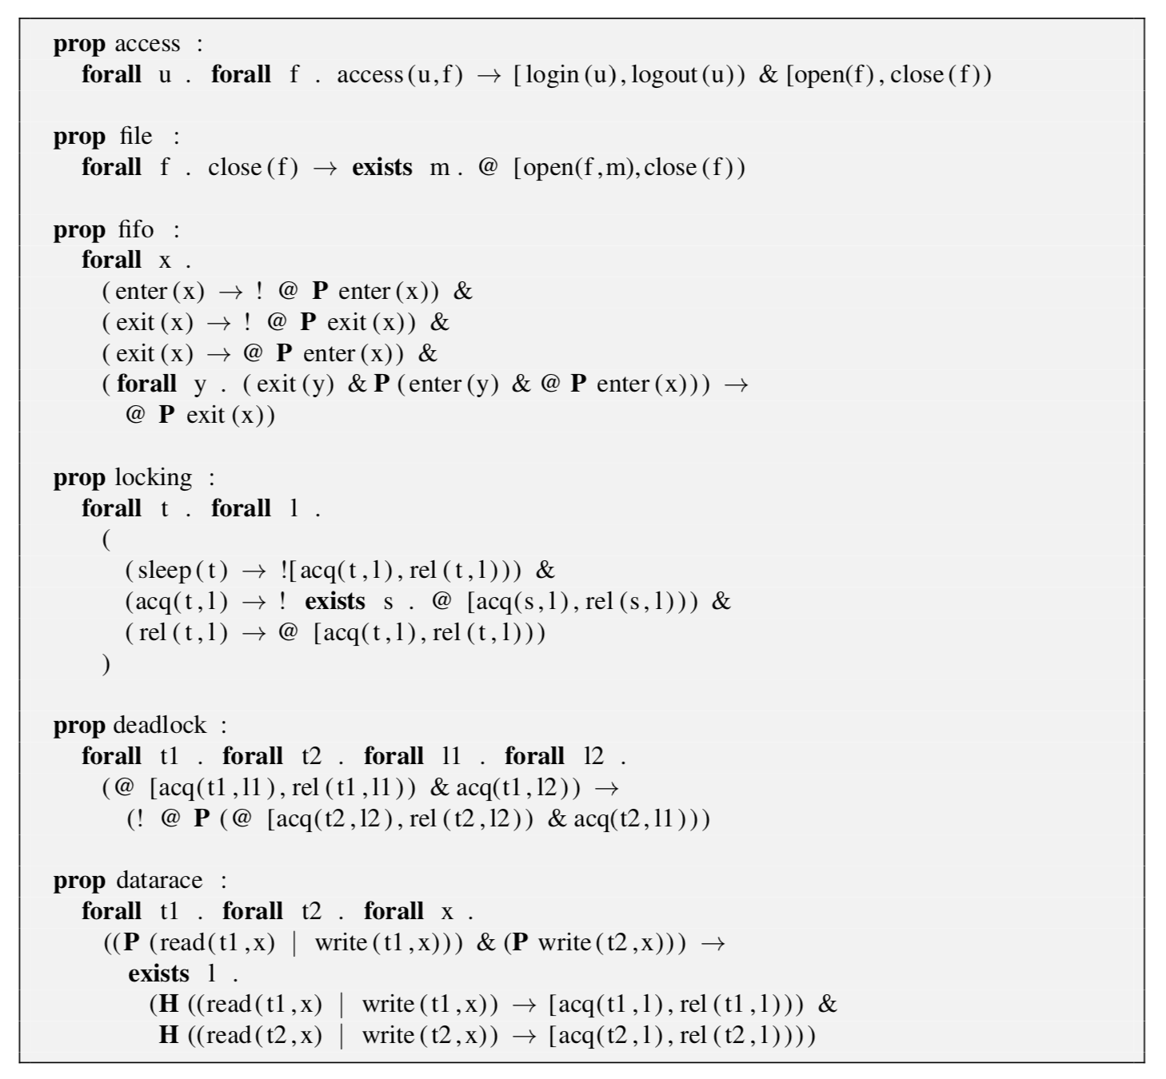

Slide 55
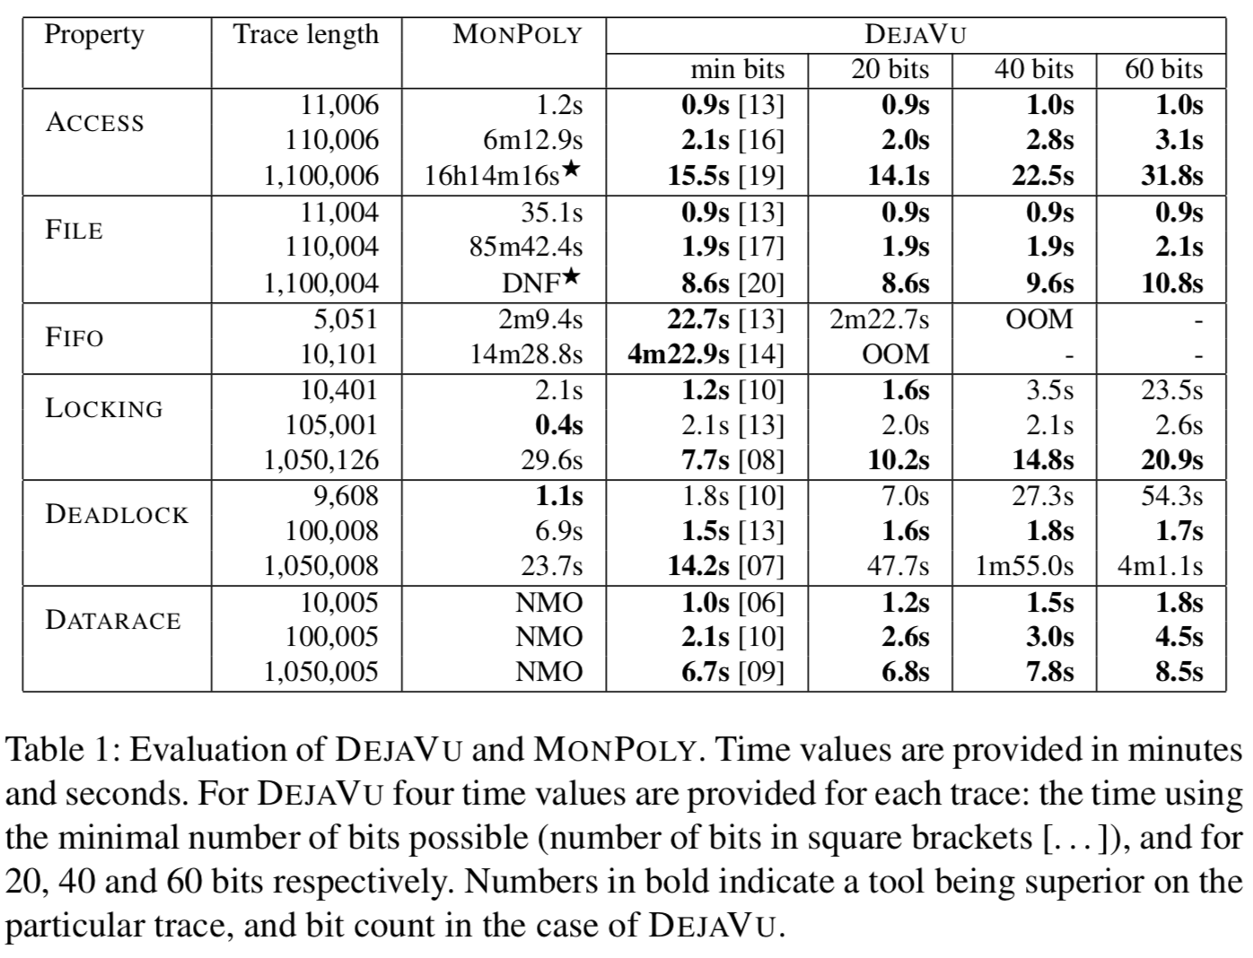

Slide 56
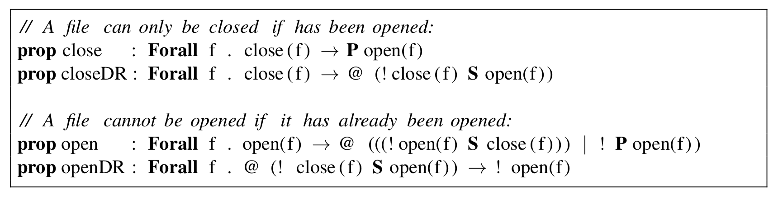
Experimenting with Garbage Collection

Slide 57
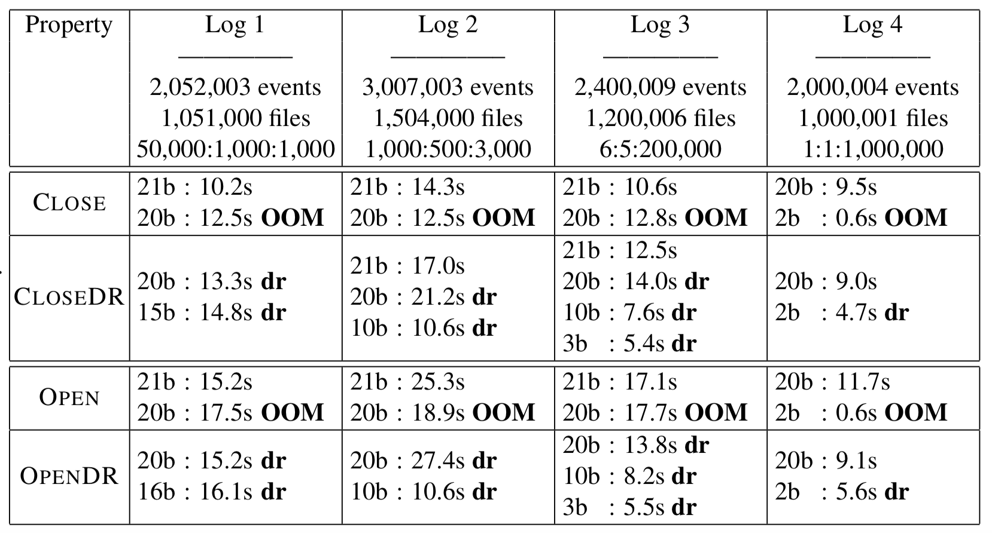

Slide 58
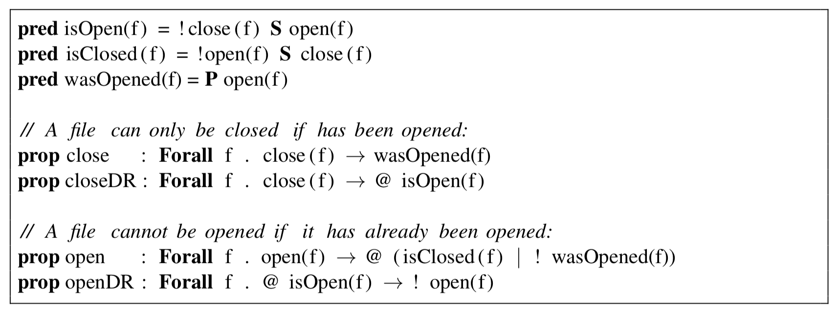
Macros

Slide 59
Conclusions
We support first-order past time temporal logic with relations and two forms of quantifiers: over finite domains of so far observed values, and over infinite domains of all possible values.
BDDs are efficient for representing infinite state spaces where we at any time have only observed a finite part.
Compact. With n bits we can represent 2^{n} values. We expect to pay little for “surplus” bits.
Values not yet seen are represented by unused bit patterns.
We can extend the BDDs with additional bits dynamically if needed.
Complementation is efficient (just switching the F and T leaves).
Data collection does not seem to impair efficiency of monitoring. On the contrary: fewer bits per variable and more frequent data collection can improve efficiency (this was unexpected).
Future work includes
  Experiments with variable orderings.
  Introducing functions on data values.
  Real-time constraints.
  Making logic more expressive by integrating temporal logic and rule systems.

Slide 60
END

